Slide 1
Iota Gamma Directory Conversion Project
Executive Summary
Working Group 4 Peter Palmisano, Instructor
Sue Argentieri | Peres Doubeni |Ingrid Henricksen | Luis Sanchez-Artu

Slide 2

Agenda
Why
What
How
Demonstration

Slide 3
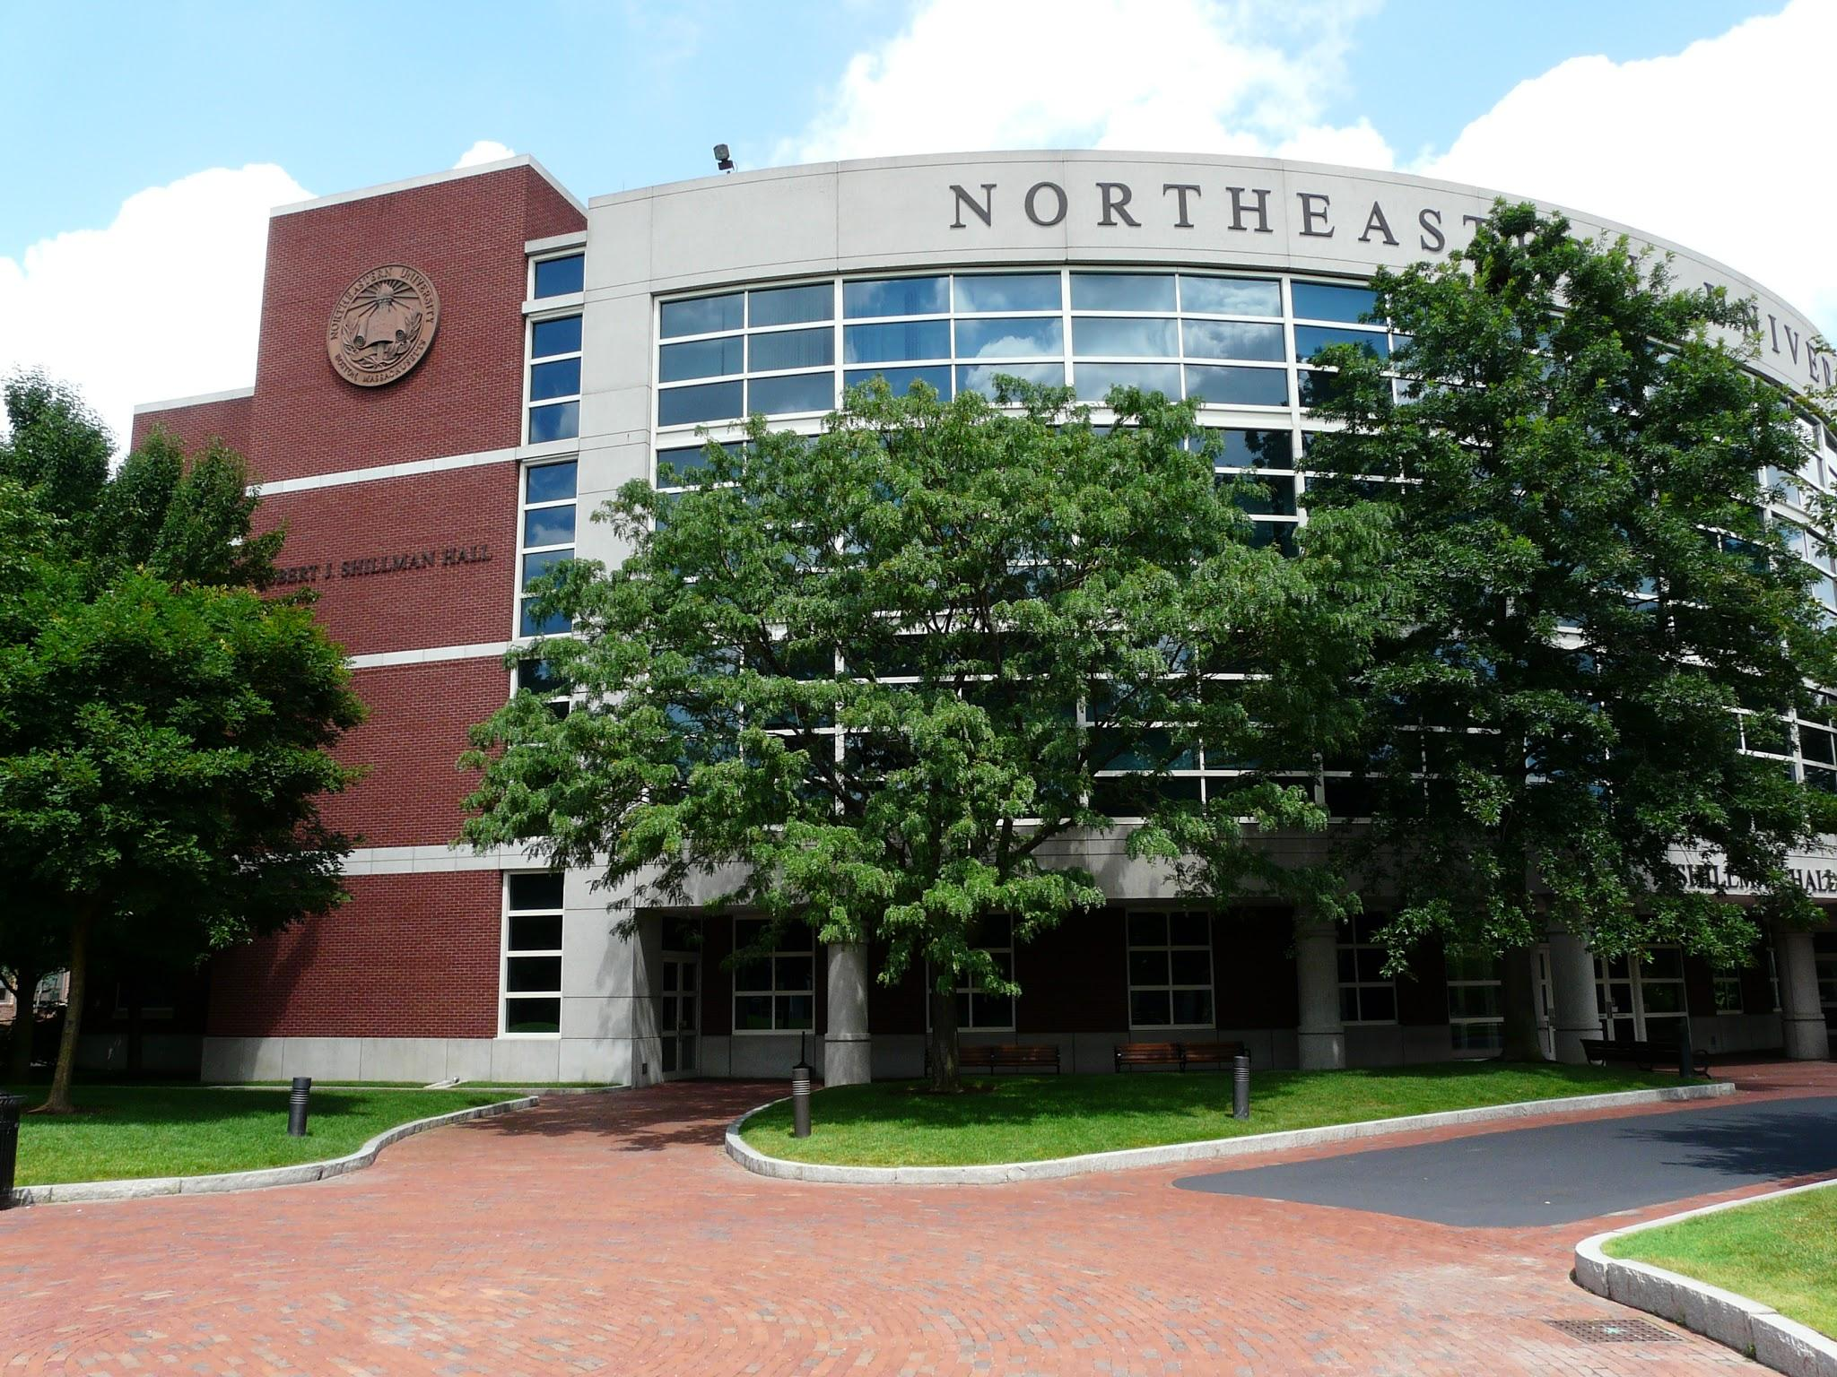

WHY: The Inspiration(Business Case)

Slide 4
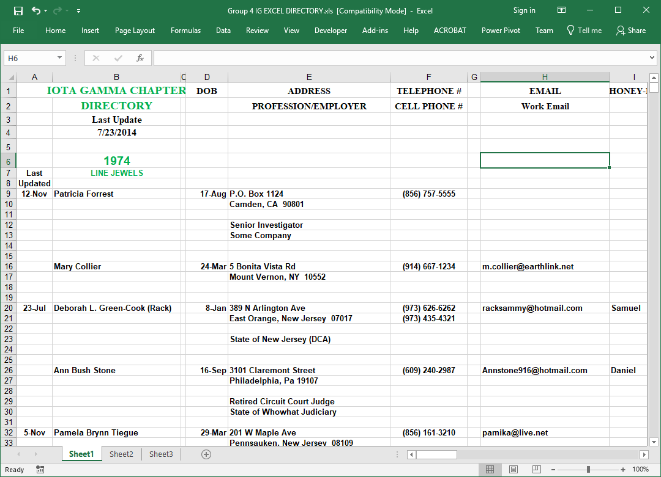
The Problems
Managing information
Sharing information
Consistency
Security
Notes:
Managed by one person
Transmitted via email
Multiple copies
Data lacks integrity
Not easily searchable
Green represents new group
Inconsistent spacing
Incomplete information

Slide 5

WHAT
Controlled and secured access
Centralized
Backed-up
Consistent

Slide 6

…. a web-based directory!
Major Deliverables
A database
An access control list
Centralized data repository
Improved data quality
Backups

Slide 7
HOW
Careful Development:
Front and Back-end scripts
Database architecture
Lots of planning:
Wireframe
Class domains
Activity Diagrams
System Sequence Diagrams
Notes:
DO we have any javascript here?

Slide 8
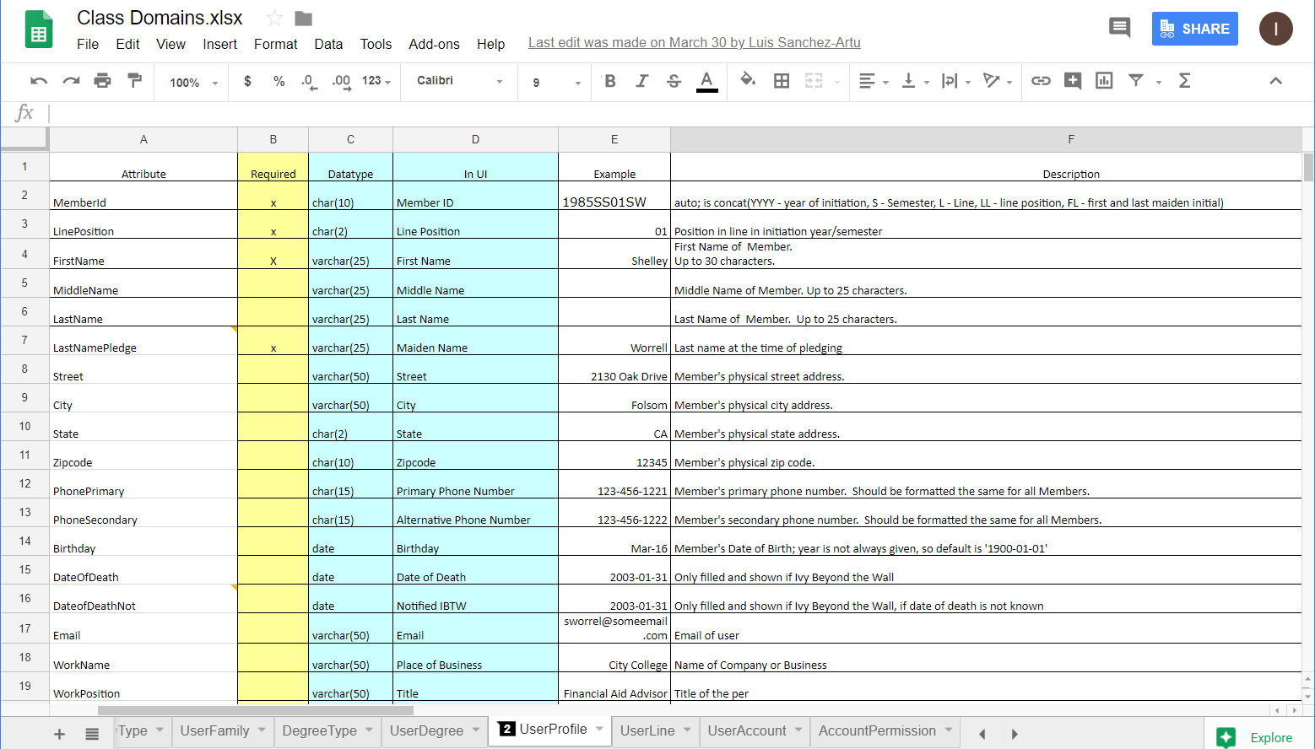
Class Domains

Slide 9
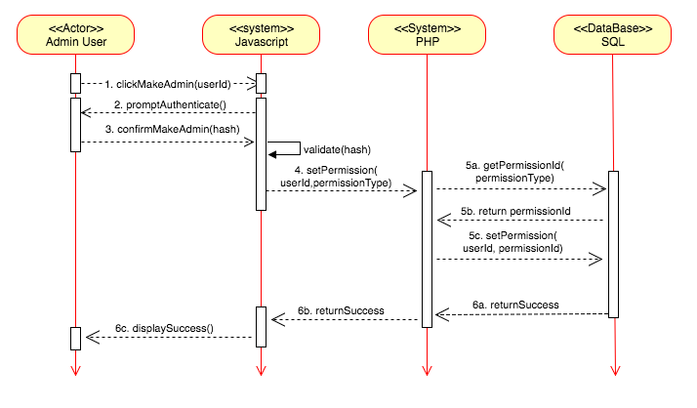
System Sequence Diagrams

Slide 10

Front-End
The front-end is a website portal developed on one.com:
HTML
CSS
PHP
Sql
javascript
Notes:
DO we have any javascript here?

Slide 11
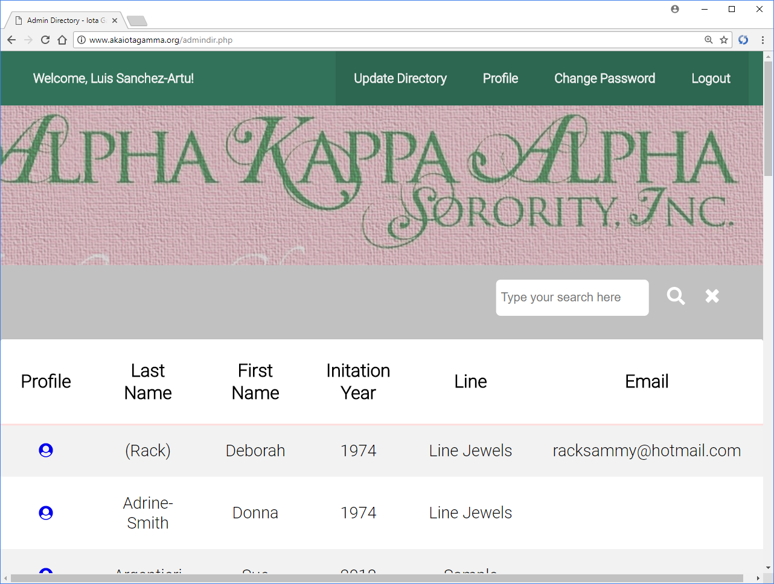
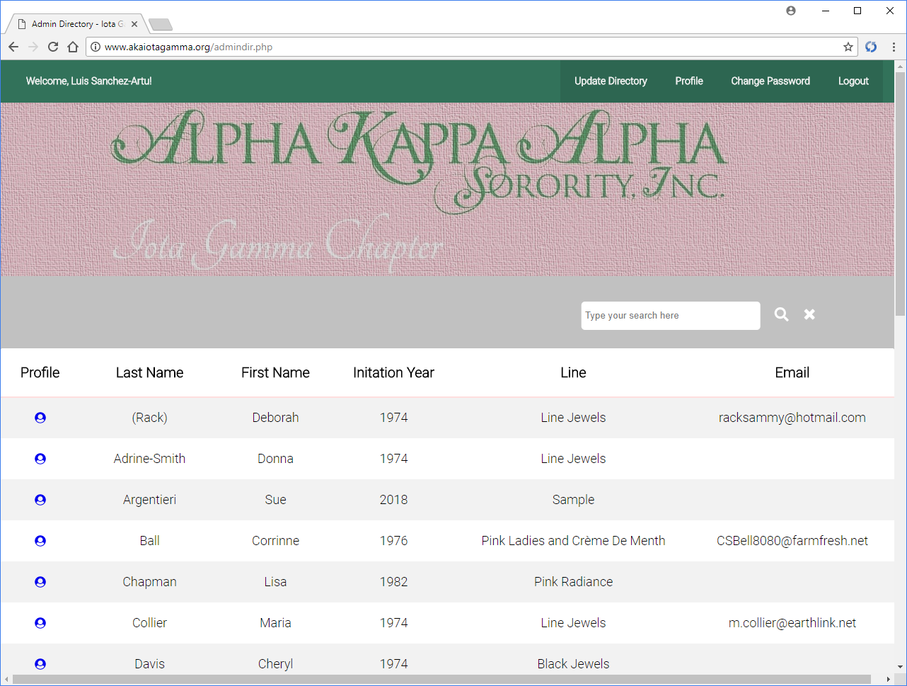
Features
Authorized access
Administrative control
Members can edit their own profiles

Slide 12
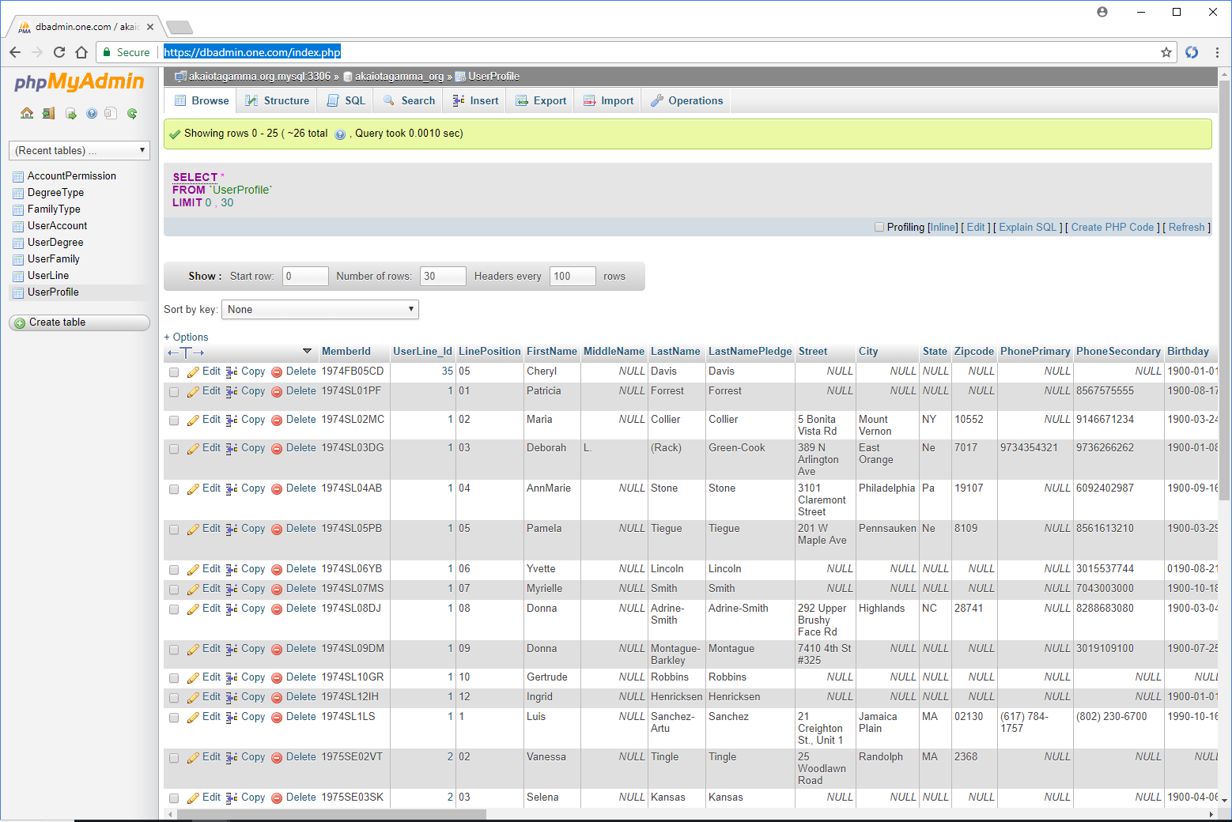
Back-End
The back-end was created with one.com’s native Relational Database Management System, MariaDB
Integrity
Availability

Slide 13
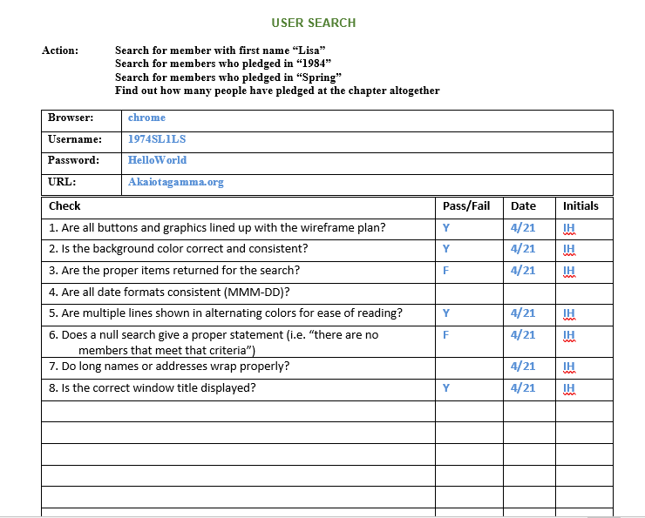
Quality Assurance
Lots of testing

Slide 14
Presentation:
AKAiotagamma.org

Slide 15
The Team
Role | Member
Project Manager | Ingrid Henricksen
Member-at-Large | Peres Doubeni
Web Developer | Sue Argentieri
Software Programmer | Luis Sanchez-Artu

Slide 16
Challenges we faced
Slow responses from sponsor
Differences in programming styles

Slide 17
The Numbers
Changes
SPI | 1.000
Schedule Variance | $ -
CPI | 1.199
Cost Variance | $ 5,488.32

Slide 18
Lessons Learned
Communication is key
Value of documentation
Provide standards

Slide 19
Questions?

